Slide 1






DISASTERS KNOW NO BORDERS
Fires, tsunamis, hurricanes, flooding, earth quakes, child trafficking, viruses, pandemics, auto trafficking, abductions and tourists
PROJECT FOR THE CARIBBEAN REGION
PRESENTED BY
THE CELLULAR EMERGENCY ALERT SERVICES ASSOCIATION
of Civil Information Societies EMERGENCY COMMUNICATIONS WORKING GROUP and ONEWORLD UPSEN ALLIANCE

Slide 2
6 Billion people do not have access to early warning messages
Technology has been available for more than 20 years
Global messaging standards and protocols are in place
Early Warnings save lives and property
Governments spend funds to adopt less reliable solutions
Governments subject their systems to data breach and misinformation

Slide 3


CB Versus SMS
Nearly 30 Nations have deployed Gen 1 Cell Broadcast systems
All these deployments purchased CBC systems and have constant on-going maintenance and training costs yearly,
Many have on-going legal battles, defending Government after system failures (most human decision errors),
Numerous Nations have been sold SMS systems disguised as a CB solution because the vendor says it uses CB based CAP messaging.
Numerous global bodies have specifically stated SMS solutions will not work and are not recommended for Mass Emergency Warning.
Most Nations have representation on these standards bodies for more than 25 years.

Slide 4




How to tell the difference between CB and SMS
Short Messaging Solutions (SMS) require:
the constant monitoring of a database of device locations and network and device details.
a connection must be established between sender and receiver
all traffic to be handled on mobile networks’ communication bandwidth
all message recipients to opt into service.
Gen 1 – CB Solutions requires
Upfront capital for purchase of 1 or more National Cell Broadcast centers
On-going maintenance and training of personnel on system messaging protocols, formatting, authorization authentication and dissemination rules
No receiver database or opt in required.

Slide 5
Global Bodies have been calling for a Global Messaging platform for ten years
2015 - More than 200 Nations joined Sendai Framework (link to document)
2022 – UN calls on world to develop and implement a Global Messaging solution by 2025 (link to Guterres Video)
2023 – WMO calls on Gen 1 developer to implement a Global messaging solution – UPSEN is developed.
2024 - Universal Public Service Emergency Notification (UPSEN) system ready for global deployments.
Global Alerts Corp. begins to approach National Governments and their respective telecommunication regulators with the next generation (GEN 2) of CB based Regional and Global

Slide 6

Objective of UPSEN
Is to provide for the safety of all nations and people by resolving the prohibitive cost and operational complexities inherent in all current wireless emergency alerting systems.
While intended as a solution for enabling ‘Gap’, nations to obtain the added safety of national warnings, the UPSEN Personal Alert feature has a regional scope that complements existing programs by delivering seamless cross-border notifications, (i.e. child trafficking).

Slide 7
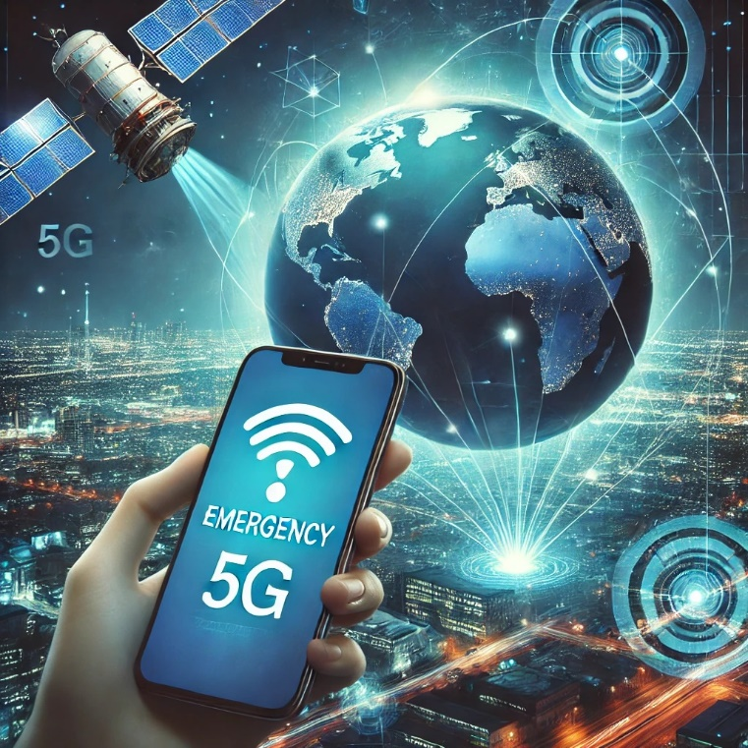
What is UPSEN
Universal public service emergency notification is a wireless telecommunications feature, not a government acquisition.
Service dedicated to providing early warning for all nations as a non-revenue messaging feature available to regulatory governments by land-based and 5-g satellite telecommunications providers as a public service obligation of radio spectrum…
The UPSEN Personal Alert messaging feature supports the establishment of universal multi-hazard early warning as expressed by ‘Target ‘G’ of the UN ‘Sendai Framework for Disaster Risk Reduction’.

Slide 8

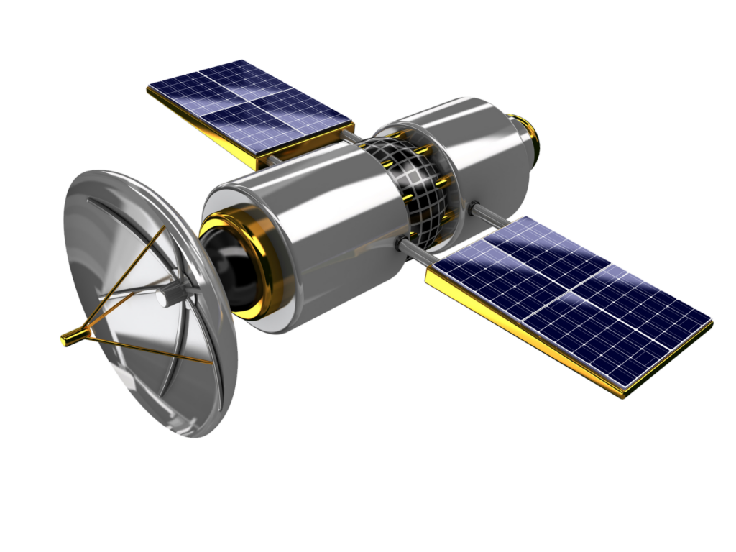
UPSEN Proposal
UPSEN proposes that ‘Warning for All’ should not be an exclusive responsibility of government…
Providing wireless users access to emergency information should be a moral obligation of personal telecommunication,

Slide 9
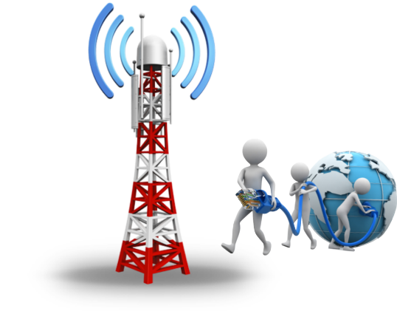
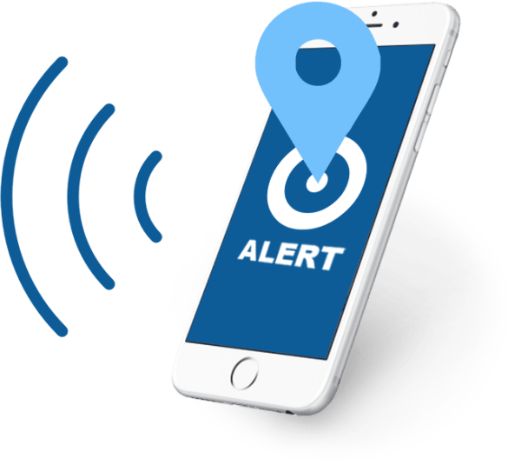


Role of Wireless Industry
Given that the need, feasibility, and humanitarian benefit of wireless emergency alerting has been well established.
Personal telecom providers have the authority and moral obligation to provide users Universal Public Service Emergency Notifications

Slide 10
UPSEN Deliverables
A ‘no-cost’ emergency warning capability,
Automated wireless emergency alerting,
Self-funding revenue sustainability,
Internationally harmonized alerting,
Borderless event notifications,
Default, not opt-in, connectivity to all wireless handset devices
Enhanced safety and security for all people

Slide 11
Messaging Practices
UPSEN messaging is held to three recognized principals:
1. Common Alerting Protocol
(CAP) is a highly advanced and secure multimedia data dissemination format. CAP universally authenticates the non-repudiation of alert originators and verifies the alerting actions comply with territorial authorization,
2. National Sovereignty and Jurisdiction
The right to mandate action by a nation’s population is exclusively that of government and cannot be superseded by ‘outside’ organizations regardless of how altruistic the purpose,
3. National Regulatory Framework
All nation states have regulatory bodies responsible for the orderly administration and licensed use of radio spectrum according to international agreements.

Slide 12


THANK YOU
For more information or to join UPSEN, please go to
nations@upsenoneworld.org
www.upsenoneworld.org

